Slide 1
Steve Volk
Oberlin Community Supporting Immigrants (OCSI)

Slide 2
This presentation should not be considered legal advice
Before applying for any type of immigration benefit, you should contact a licensed immigration attorney or speak to a DOJ accredited representative

Slide 3
Agenda and Purpose
Who enforces immigration determinations?
Understanding the constitutional basis of immigrant rights
So community members can defend those rights
For immigrants to protect themselves
Protecting rights:
At home
At work
At school
In transit
What can we do to protect and defend community members
Q&A

Slide 4
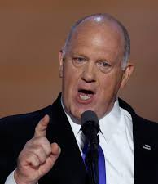
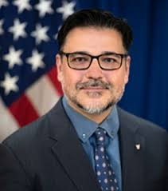
Trump’s Immigration Policy Nominees and appointees
Rodney Scott
Commissioner of Customs and Border Protection (CBP)
Former Border Patrol chief
Stephen Miller
Deputy Chief of Staff
Ideologue behind policies
Tom Homan
Border “Czar”
Former head of ICE
Caleb Vitello
Acting Dir. ICE
23 years in ICE
Chief of Staff for Enforcement and Removal Operations
Tony Salisbury
Deputy Homeland Security Advisor
Special Agent in Charge of ICE, Miami

Slide 6
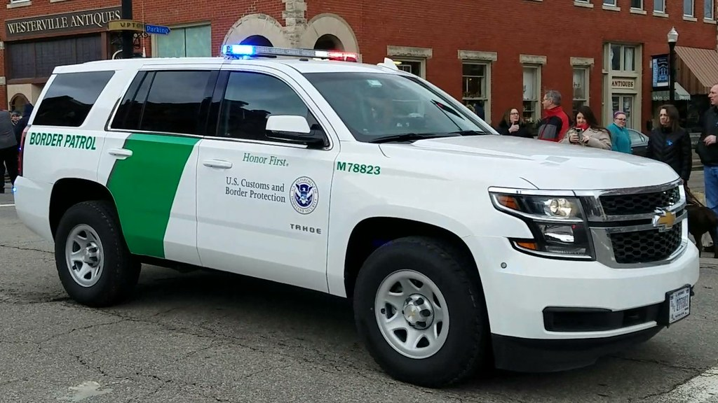
Who Else?
Lorain County Sheriff’s Department
Oberlin Police
Department
Lorain County Sheriff
Border Patrol

Slide 7
What Are Your Rights?
¿Cuales Son Sus Derechos?
4th Amendment: Protections against unreasonable searches & seizures
5th Amendment: Right to remain silent
14th Amendment: Right to due process

Slide 8
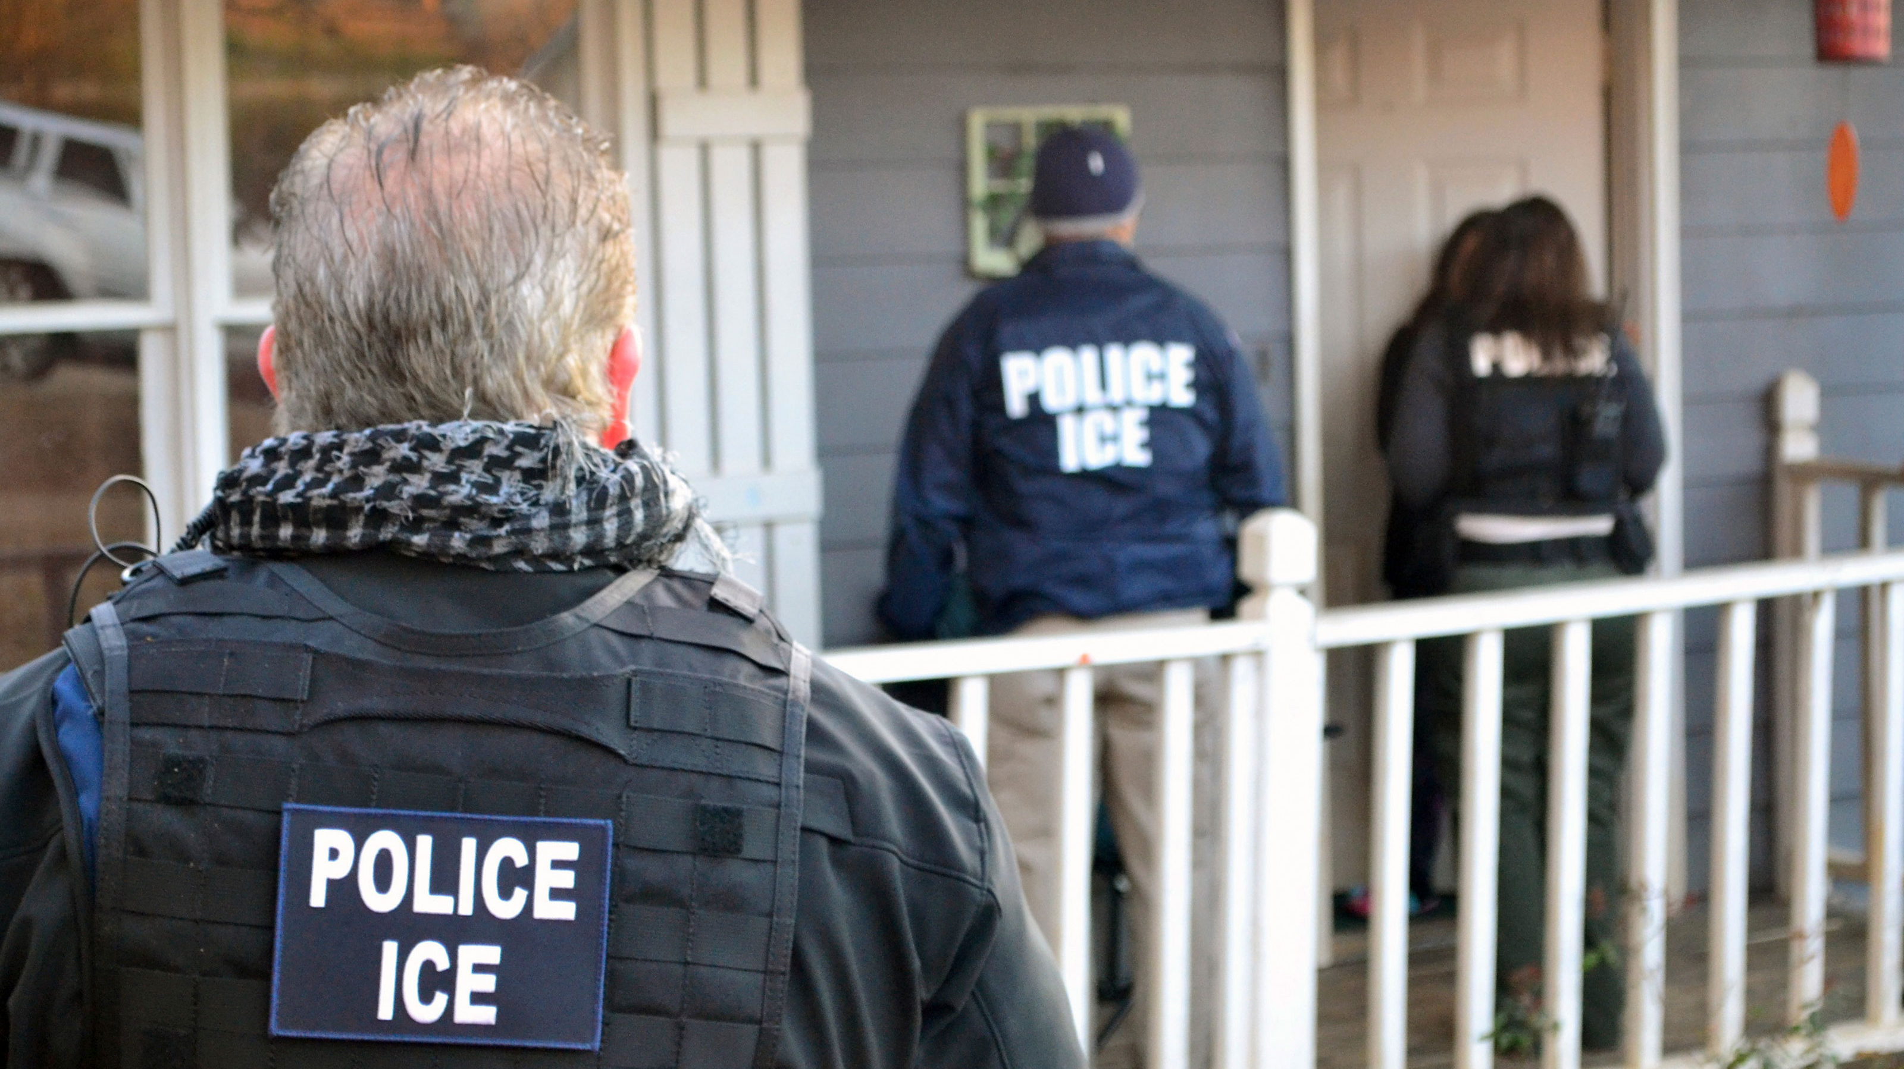
If ICE comes to your HOME/
Si ICE aparece a su CASA

Slide 9
If ICE comes to your HOME/
Si aparece a su CASA
DO NOT open your door
Ask who it is - You have the right to request the name and identification of any officer you speak to;
Ask to see a warrant – have them put it under the door or show it through a window.
NO abre la puerta
Pregunta quien es: tiene el derecho de pedir el nombre y identificación de cualquier agente;
Exige un orden judicial – que lo ponga debajo de la puerta o lo muestra por la ventana.

Slide 10
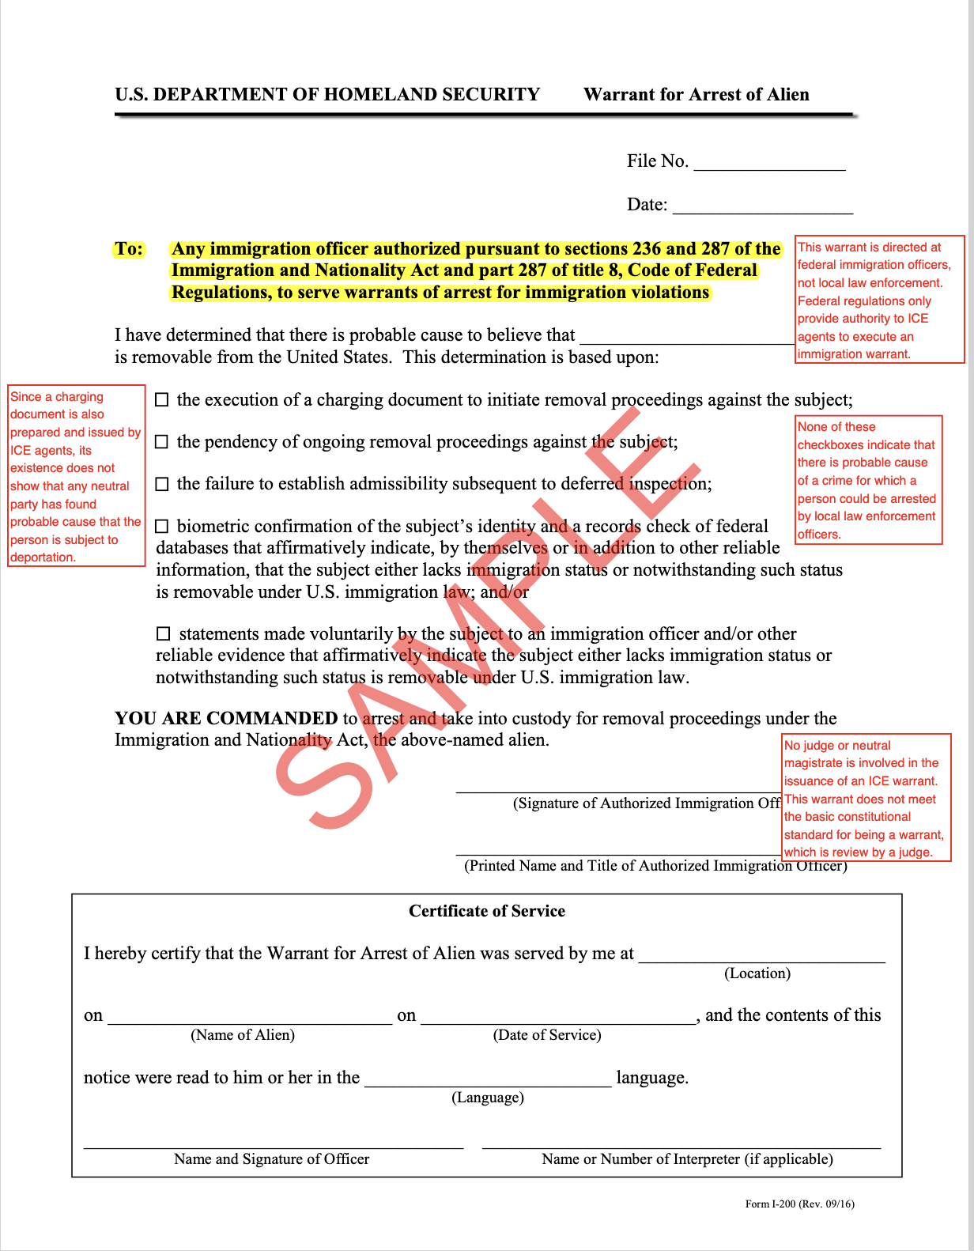
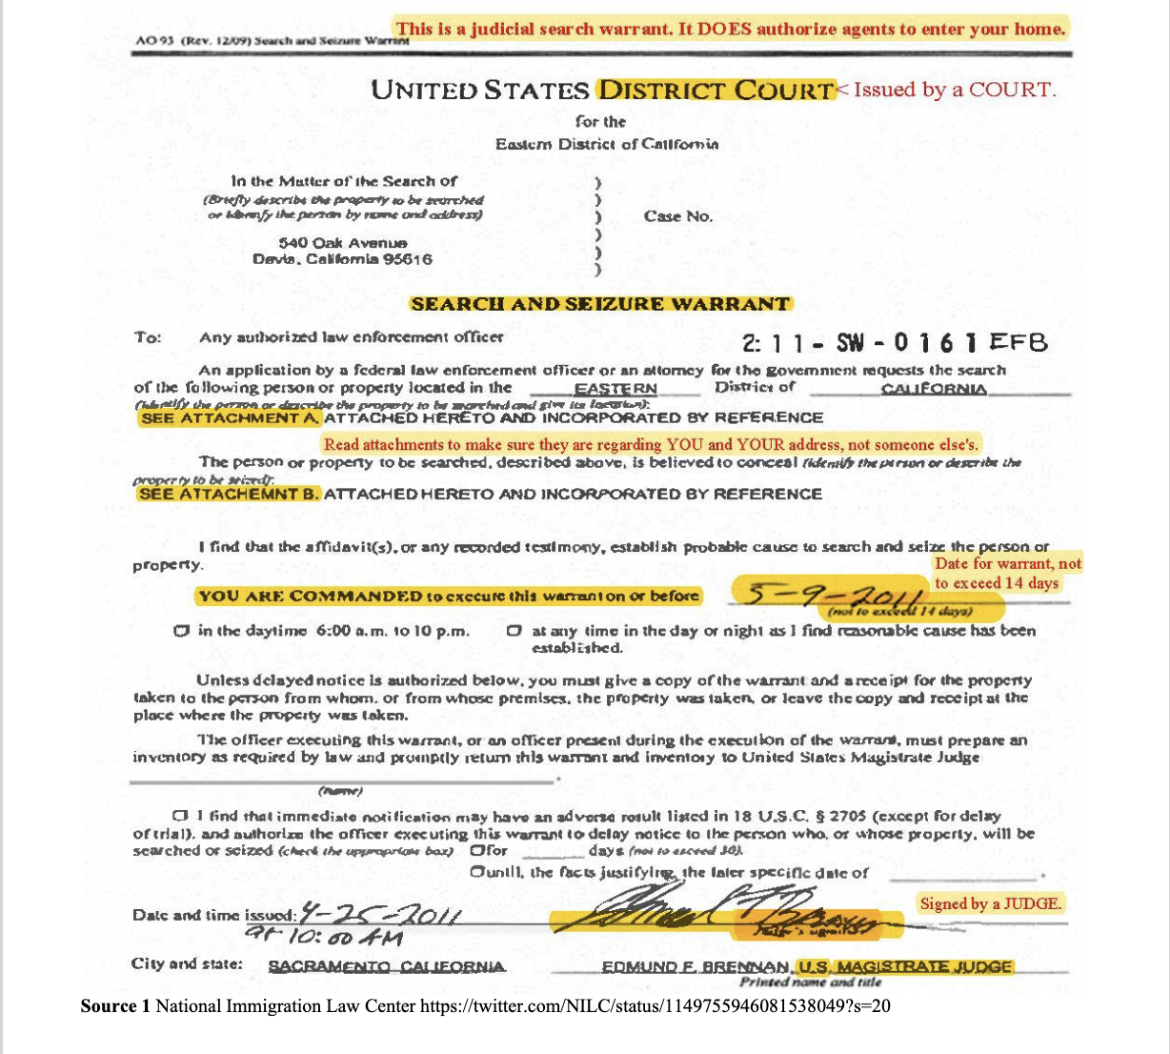
Judicial Warrant
Valid if filled out properly
DHS (ICE)
Administrative (Civil) Warrant

Slide 11
You Have Rights/ Usted Tiene Derechos
Without a JUDICIAL WARRANT, only YOU can allow an immigration officer into your home.
Sin un ORDEN JUDICIAL, usted SOLO puede permitir que la migra entre en su casa.

Slide 12
If ICE comes to your HOME/
Si aparece a su CASA
You can remain silent, but you MUST state: “I am exercising my rights not to open the door or speak with you” and present them with a “KNOW YOUR RIGHTS” card.
Puede guardar silencio, pero diga: “I am exercising my rights not to open the door or speak with you.” Les puede pasar una tarjeta “KNOW YOUR RIGHTS” debajo de la puerta cerrada.

Slide 14
If ICE comes to your WORK PLACE/
Si llega ICE a su EMPLEO

Slide 15
If ICE comes to your WORK PLACE/
Si llega ICE a su EMPLEO
● ICE can lawfully enter a workplace without permission if it is open to the public.
● ICE puede entrar en su lugar de trabajo si está permitida la entrada del público.

Slide 16
If ICE comes to your WORK PLACE/
Si llega ICE a su EMPLEO
● ICE can only enter a private space (1) with a legal (judicial) warrant, or (2) the consent of the employer/owner of the establishment.
● Si es privado, ICE puede entrar solamente (1) con un ORDEN JUDICIAL, o (2) con el permiso de su empleador.

Slide 17
If ICE comes to your WORK PLACE/
Si llega ICE a su EMPLEO
You have the right to remain silent.
You should have a plan with co-workers.
Tiene el derecho de guardar silencio.
Debe desarrollar un plan con los otros empleados

Slide 18
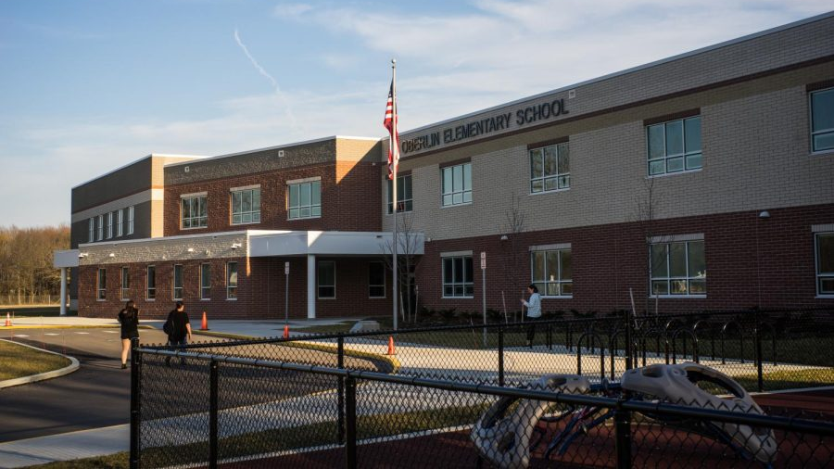
If ICE comes to your SCHOOL/
Si aparace ICE en las ESCUELAS

Slide 19
If ICE comes to your SCHOOL/
Si aparece ICE en las ESCUELAS
ICE agents can only enter non-public areas of a school with the permission of a school administrator.
ICE agents should be asked to wait until a school attorney can arrive.
Solamente pueden entrar las zonas no-públicas con la autorización de un administrador de la escuela.
Agentes de ICE deben esperar hasta que llegue un abogado de la escuela.

Slide 20
If ICE comes to your SCHOOL/
Si aparece ICE en las ESCUELAS
School administrators should ask to see a JUDICIAL warrant (not an ICE detainer) before allowing ICE agents inside.
Should ICE agents show up outside a school building, (trained) school administrators can tell students that they don’t have to talk to the agents.
Los administradores deben solicitor un ORDEN JUDICIAL antes de dejar entrar un agente de ICE.
Si aparece ICE en las afueras de la escuela, un administrador de la escuela (entrenado) deben avisar a los que entran que puedan guardar silencio.

Slide 21
If ICE comes to your SCHOOL/
Si aparece ICE en las ESCUELAS
Any parents/guardians impacted by such a visit should be notified immediately.
La escuela debe contactar inmediatamente a los padres que estén impactados.

Slide 22
If ICE comes to OBERLIN COLLEGE/
Si llega a OBERLIN COLLEGE

Slide 23
If ICE comes to the College/
En Oberlin College
Appropriate College admin (General Counsel, Chief of Staff, etc.) should be notified if ICE agents are on campus.
Appropriate College admin should ask to see a JUDICIAL warrant before allowing ICE to remain on campus.
Si ICE aparesca en la universidad, los oficials apropiados deben ser notificados inmediatamente.
Deben pedir ver un ORDEN JUDICIAL antes de permitir que los agentes quedan en el espacio universitario.

Slide 24
If ICE comes to the College/
En Oberlin College
Campus admin should remain with any agent who lacks a JUDICIAL warrant.
Campus admin should inform students/employees of their right to remain silent if questioned.
The college should inform students if ICE on campus.
Oficiales de la uni deben quedarse con agentes si no tienen un ORDER JUDICIAL.
Oficiales de la uni deben informar a los estudiantes/ empleados de su derecho de mantener silencio.
Oficiales deben informar los estudiantes si ICE está presente.

Slide 25
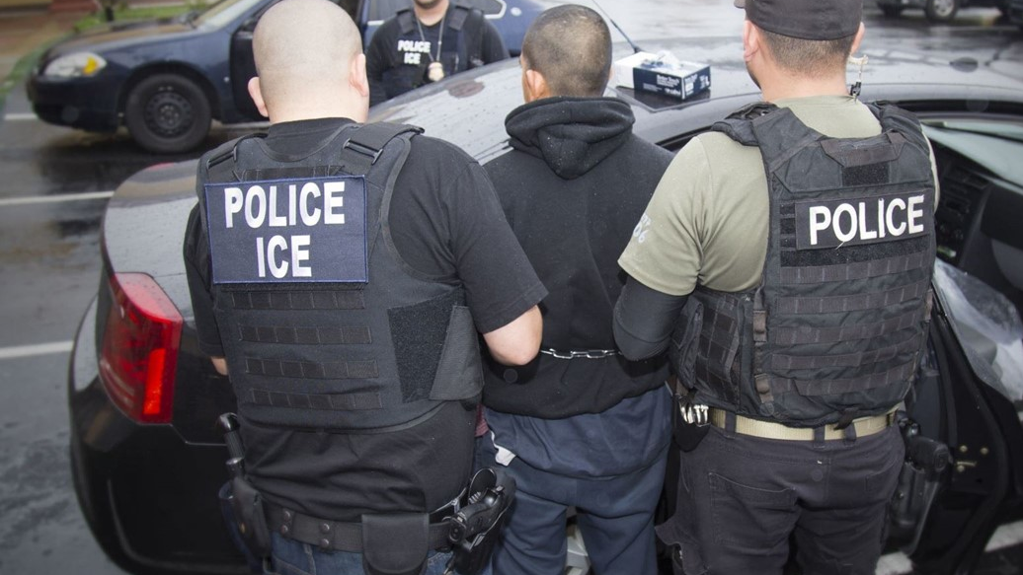
Your rights in public spaces/
Sus derechos en lugares públicos

Slide 26
Your Rights in Public Spaces
En Espacios Públicos
En Ohio, si la policía sospecha que hayas comitado un crimen, tiene que dar su NOMBRE, DIRECCION, Y FECHA DE NACIMIENTO, nada más.
Puede guardar silencio, diciendo que “I am exercising my right to remain silent” (o dales una tarjeta “Know Your Rights”).
Puede preguntar: “¿Puedo salir?” y salga DESPACIO con su permiso.
In Ohio, if the police suspect that you have committed a crime, you have to give your NAME, ADDRESS, and DATE OF BIRTH. NOTHING ELSE.
You can remain silent: Be sure to say: “I am exercising my right to remain silent” (or show a “Know Your Rights” card).
You can ask: “Am I free to go?” and, if so, walk away SLOWLY.

Slide 27
Your Rights in Public Spaces
En Espacios Públicos
DO NOT:
Run
Provide any non-US identification (e.g. passport)
Lie
If searched, say: “I do not consent to this search!”
NO
Corre
Muestra identificación (como un pasaporte) de un país extranjero
Miente
Si le cachea, diga: “I do not consent to this search!”

Slide 28
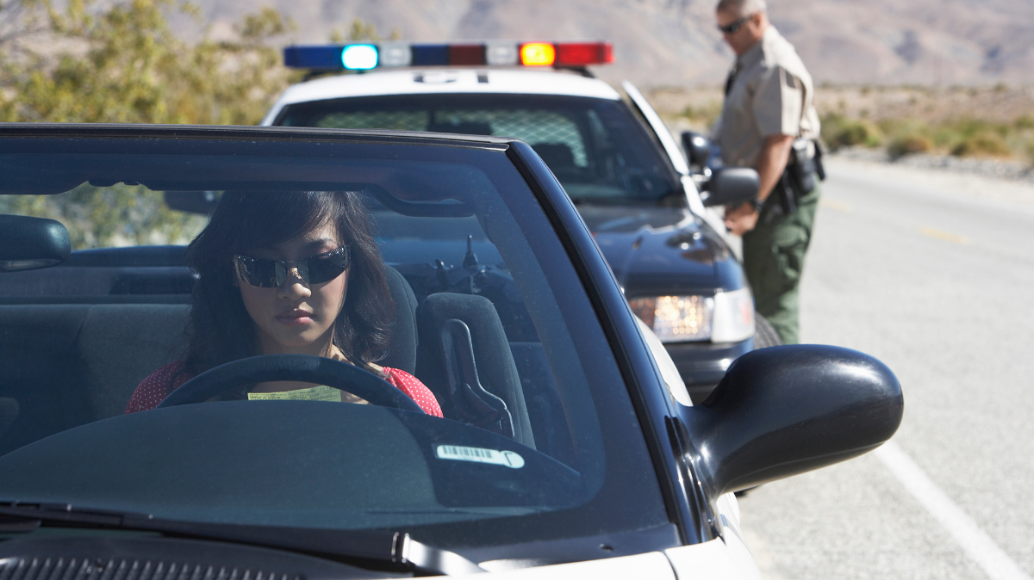
Your rights in a CAR: As a driver
Si está manejando un CARRO

Slide 29
Your rights in a CAR: As a Driver/
Si está manejando un CARRO
You must provide license, registration, and proof of insurance;
You have the right to remain silent;
Do not lie or provide false documentation;
If you or your car is searched, say, “I do not consent to this search.”
Tiene que mostrar su licencia de conducer, el registro del carro, y prueba de seguridad
Tiene el derecho de guardar silencio;
No miente ni darles identificación falsa;
Si le cachea, diga: “I do not consent to this search.”

Slide 30
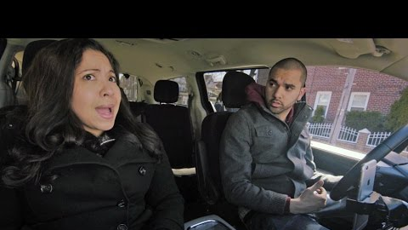
Your rights in a CAR: As a passenger/
Como PASAJERO

Slide 31
Your rights in a CAR: As a passenger/
Sus derechos como PASAJERO
In Ohio, passengers are not required to carry identification or to produce it for law enforcement.
You have the right to remain silent. If you are searched, you should state that you don’t consent.
You can ask if you’re free to go and, if so, walk away.
En Ohio, los pasajeros no tienen que llevar ni mostrar identificación.
Tiene el derecho de guardar silencio y oponerse a un cacheo
Puede preguntar: “¿Puedo salir?” y salga DESPACIO con su permiso.

Slide 32
What Are Your Rights?
¿Cuales Son Sus Derechos?
4th Amendment: Protections against unreasonable searches & seizures
5th Amendment: Right to remain silent
14th Amendment: Right to due process

Slide 33
PROTECTING COMMUNITY MEMBERS
Know your rights/conozca sus derechos.
Understand the current situation/mantengase alerta de la situación actual.
Don’t add to tensions by spreading unverified rumors/no aumente la ansiedad por medio de rumores.
In community there is strength/hay fuerza en la unidad.

Slide 34
Q&A?/ ¿PREGUNTAS?

Slide 35
ocsi.general.outreach@gmail.com

